Slide 1
Revisiting ResNets: Improved Training and Scaling Strategies Irwan Bello, William Fedus, Xianzhi Du, Ekin D. Cubuk Google Brain & UC Berkeley 2021, CVPR

Slide 2
Background
Performance of model: architectures, training methods, scaling strategy.
Architectures: Lenet5, AlexNet, VGG, Inception, ResNet, DenseNet,..,EfficientNet.
Scaling Strategy 1: scale model depth in regimes where overfitting can occur (width scaling is preferable otherwise .
Scaling Strategy 2: increase image resolution more slowly than previously recommended .

Slide 3
Introduction
Contribution: Resnet-RS.
1.7x - 2.7x faster than EfficientNets.
4.7x faster than EfficientNets, 86.2% top-1 accuracy in semi-supervised learning.
Better than SimCLR & SimCLRv2.
3D ResNet-RS. Improve top-1 accuracy by 4.8%.

Slide 4
Improvements on ImageNet
Architecture: AlexNet, VGG, ResNet, Inception, NasNet, EfficientNet,etc.
Training and Regularization Methods: drop out, label smoothing, augmentation.
Scaling Strategy: Model dimension(width, depth and resolution).
Additional Data: labeled, weakly labeled or unlabeled.
Problems: Most work emphasizes little on scaling stategy.

Slide 5
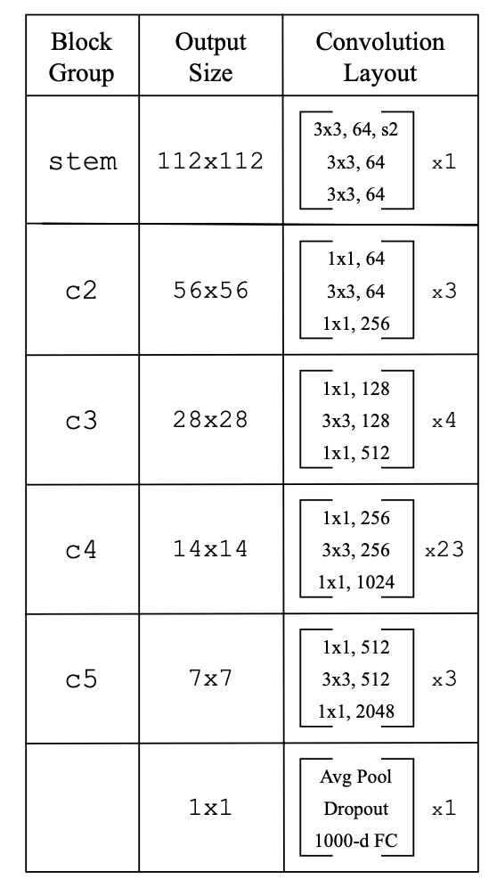
Method- Architecture
ResNet-D: Conv3*3. Strides size switched. Skip connection. Remove max pooling layer.

Slide 6
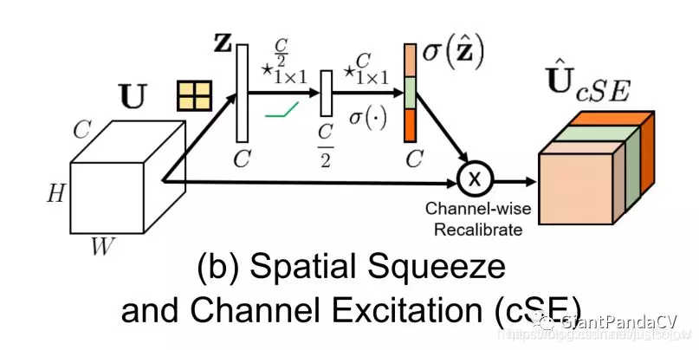
Method- Architecture
Squeeze-and-Excitation.

Slide 7
Method- Training Method
Different from EfficientNet Setup: cos learning schedule, RA.
Regularization: weight decay, label smoothing, dropout and stochastic depth.
Data Augmentation : Rand Augmentation.

Slide 8
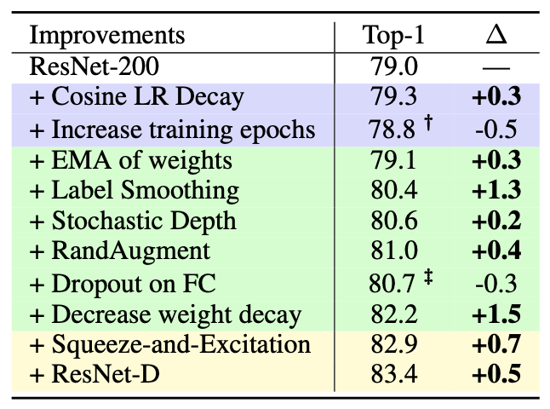
Method- Improved Training Method
Additive study: cos learning schedule, RA.
Improve 3.2%(82.2%) through improved training method.

Slide 9
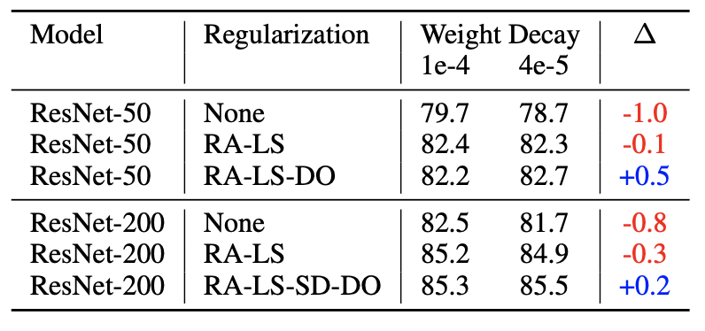
Method- Improved Training Method
Weight decay vs regularization.
Weight decay’s value must be decreased in order to not overly regularize the model .

Slide 10
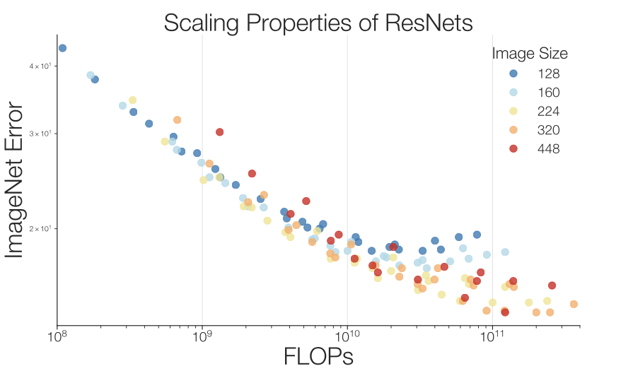
Method- Improved Scaling Strategy
Width [1.0, 1.5, 2.0], Depths [26,50,101,200,300,350,400], Re [128,160,224,320,448]
The best performing scaling strategy depends on the training regime.

Slide 11
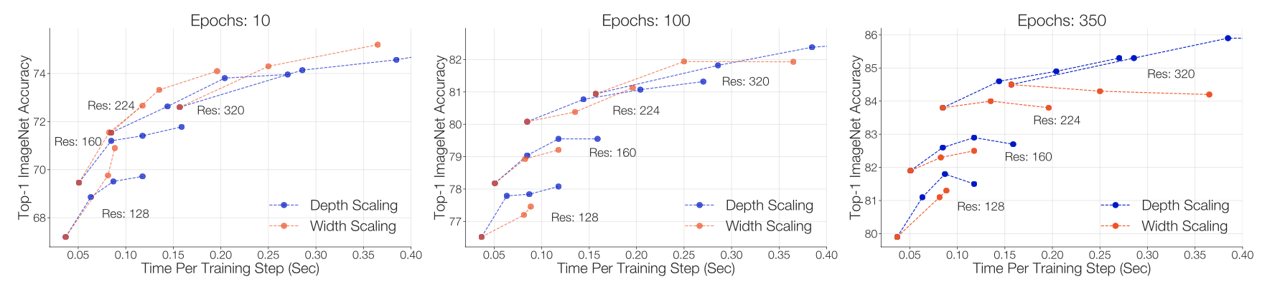
Method- Strategy#1
Width [1.0, 1.5, 2.0], Depths [101,200,300,400], Re [128,160,224,320]
The best performing scaling strategy depends on the training regime.
Depth scaling outperforms width scaling for longer epoch regimes. .

Slide 12
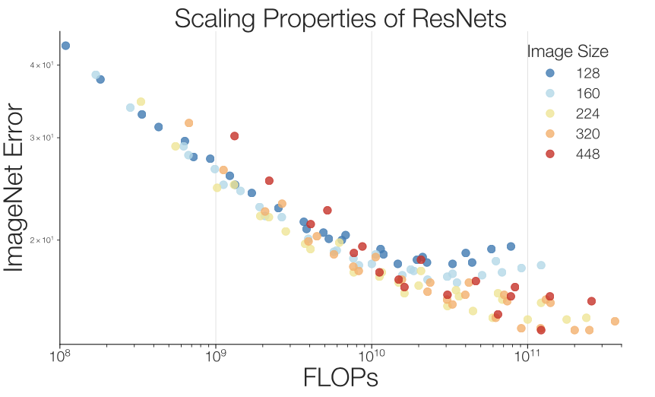
Method- Strategy#2
Slow Image Resolution Scaling
scaling the image resolution results in diminishing returns.

Slide 13
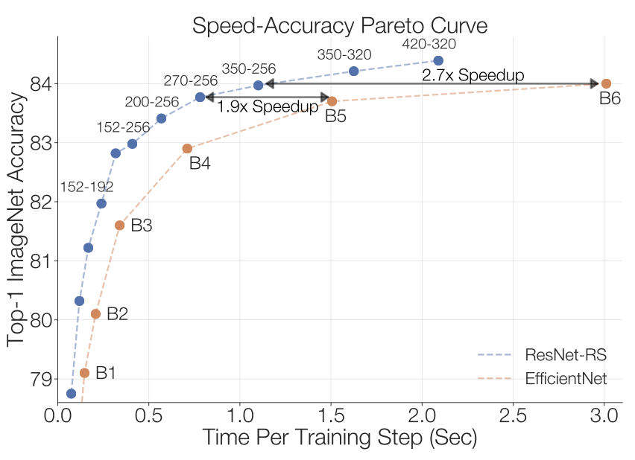
Experiment
ResNet-RS on Speed-Accuracy Basis

Slide 14
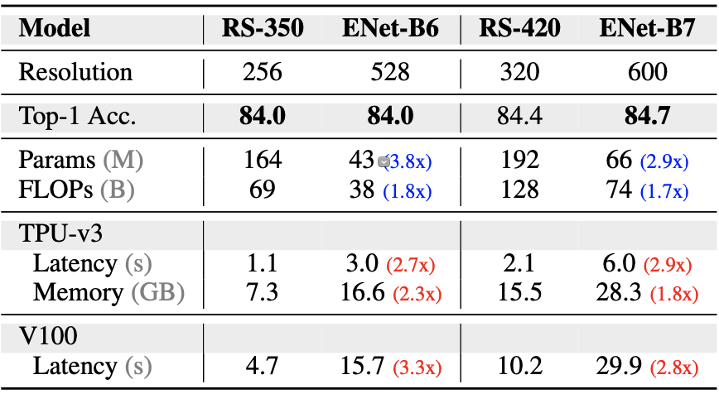
Experiment
FLOPs vs Latency & Parameters vs Memory.

Slide 15
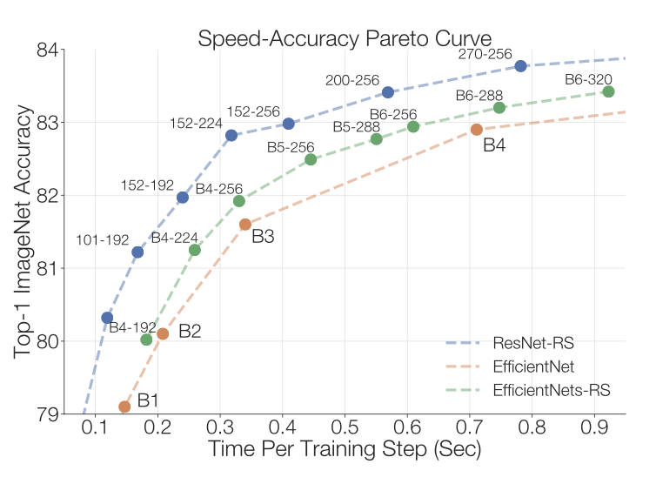
Experiment
Improving the Efficiency of EfficientNets(Strategy#2).

Slide 16
Conclusion
Training methods can be more task-specific than architectures.
It is critical to control for both aspects when comparing different architectures.
Training strategies depends on the domain and dataset sizes and scaling strategies depends on the training regime.

Slide 17
Thank you (Q&A)
Notes:
RP Shortcomings：1.relative position has multi result. 2.CNN learn trivial features. 3. not whole picture.

